Slide 1

Organization chart – Level I
HHI/HSHI UASC 14500 & 18800 TEU Container vessels
IVCS Main Project Manager Head office Norway Stein Dahle
(stein.dahle@kongsberg.com)
+47330322222
Navigation Main Project Manager Head office Norway Kazimierz Walach
(kazimierz.walach@kongsberg.com)
+4732285590
Local Advisor Busan Operation Manager Martin Lynghøi
(martin.lynghoi@kongsberg.com
+821074912321
IVCS Project Manager Busan office Korea Chang Min Park
Chang.min.park@kongsberg.com
+82517498604
Navigation Project Manager Busan office Korea Dong Hee Kim
dong.hee.kim@kongsberg.com
+82517198743
IVCS
Navigation

Slide 2
Organization chart – Level 2 Horten
HHI/HSHI UASC 14500 & 18800 TEU Container vessels
IVCS Project KM-Horten Stein Dahle
Nav. Project KM-Kongsberg Kazimierz Walach
Project: 01 KMK-Busan Dong Ju Shin
AutoChief 600
Project: 02 KMK-Busan Dong Ju Shin
Bearing wear
Project: 03
Stein Dahle Andrzej Kamecki
Line Johansen
Sun IN Choi
Project: 04
Stein Dahle Andrzej Kamecki
Line Johansen
Project: 05
Stein Dahle Andrzej Kamecki
Thomas Øksendal
Project: 06
Stein Dahle
Project: 08
Fredrik Austad
Project: 07
Kazimierz Walach
Kai Henning Lie Sven Arild Sande
Line M. Johansen
Project: 10
Kazimierz Walach
Product: Rune Melås
Product: Ørjan Sti
Product: Roald Baksaas
Product Marorka:
Sigmundur
Stefanson
Product: Johnny Johnsen
Product: Vegard Hansen
Product: Ørjan Sti
Product: Kai Henning Lie
Ship@web
K-Steering 600
K-Bridge Navigation
K-Chief 600
K-Thrust 600
VPS (Maren)
VPS (EPOS)

Slide 3
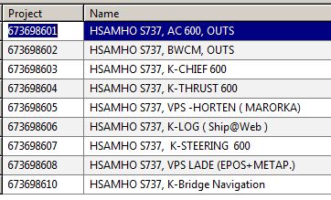
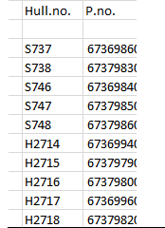
9 different project numbers each vessel
The 10 main project numbers

